Slide 1
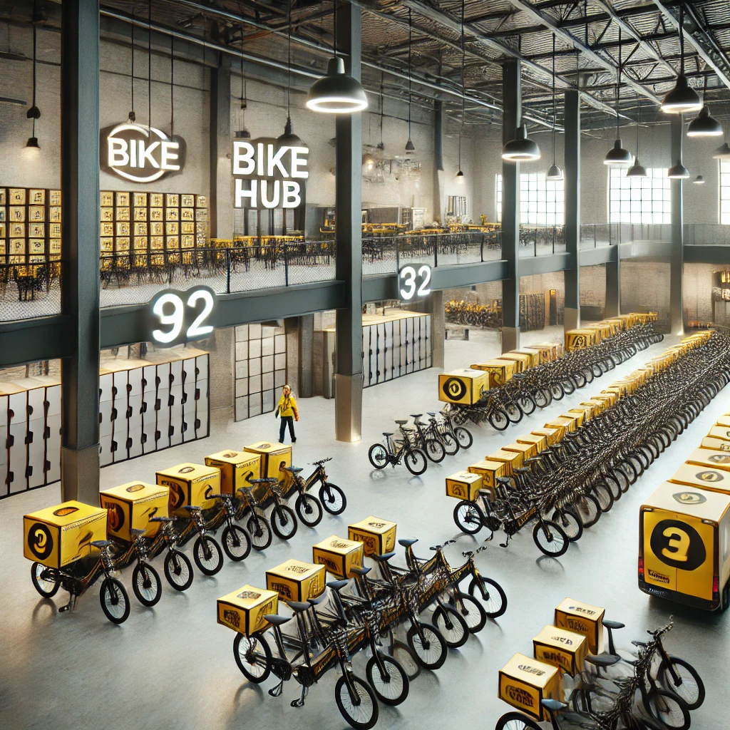


An Optimisation Approach to Planning Micro-logistics Centers for On-demand Food Delivery Service
with A Mixed Operational Model
Master Thesis Defense
Yuchen QI
30-08-2024
Notes:
Strategy https://www.tudelft.nl/en/about-tu-delft/strategy

Slide 2
Outline
Introduction
Research Question
Problem Description
Mathematical Model
Results
Conclusion
Notes:
First, I’ll introduce my project background and then I’ll describe the problem I face and the method and mathematical model I proposed to solve it
Then I’ll show you some interesting results obtained from our work

Slide 3
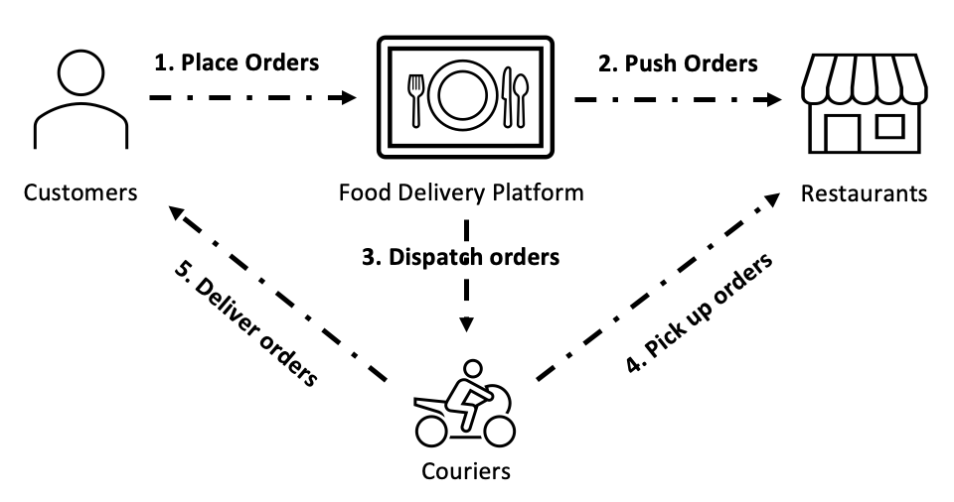



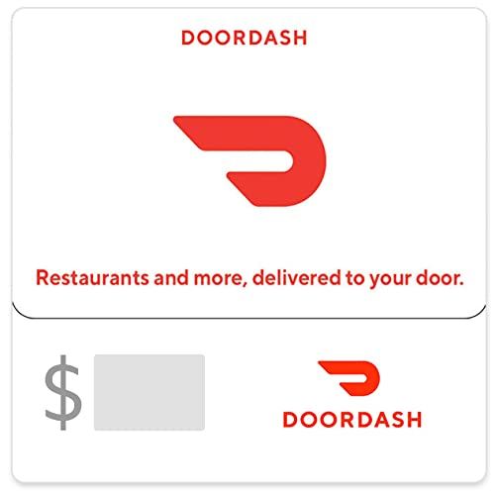
Introduction
Growing demands, Unpredictable orders, Short delivery times, Price Sensitivity…
Challenges: Control costs & Maintain Service Level
(a) Independent Contractors (IC)
(b) Company-Vehicle model (CV) with micro-logistics centers
Delivery Model:
Cost Optimization
Strategy to Different Markets
1
Notes:
We enjoy the on-demand food delivery service for its convenience as customers, which allows us to place an order and have it delivered by couriers from restaurants to our homes. It’s also interesting to look at the decisions from the platform perspective to see how they make profits and control costs. One of the important decisions is the choice of delivery model, which is closely related to the cost. There are two popular models adopted in the industry. One is operating with independent contractors and the other is to have company vehicles and micro logistics centers. And we use IC and CV to refer to these two models.

Slide 4


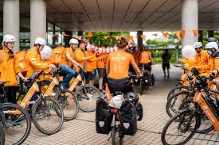
Delivery Models
Restaurants – Pick Up Order
Customers – Deliver Order
Shift Start/First Delivery
Shift End/Last Delivery
IC
CV
Shift Start
Start First Delivery
End Last Delivery
Shift End
2
Notes:
I’d like to introduce the two delivery models first. We know our friend Nessie. She has been a courier for just eat takeaway. She gets the delivery done using her personal bicycle. She is an independent contractor in our case. As for the CV model, the micro-logistics center serves as the place to accommodate these company vehicles and the courier needs to start their shift there, pick up the vehicle and travel to their first delivery locations. Also, after their last delivery, they need to return the vehicles to the center to end their shift.
(during their working period, they receive the same basic hourly salary rate, while the IC allowance for using their personal vehicle)

Slide 5
Shift Start/First Delivery
Shift End/Last Delivery
1

Slide 6
Shift Start
Start First Delivery
End Last Delivery
Shift End
1

Slide 7
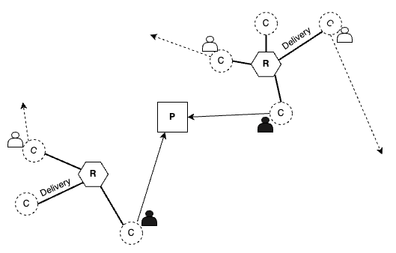
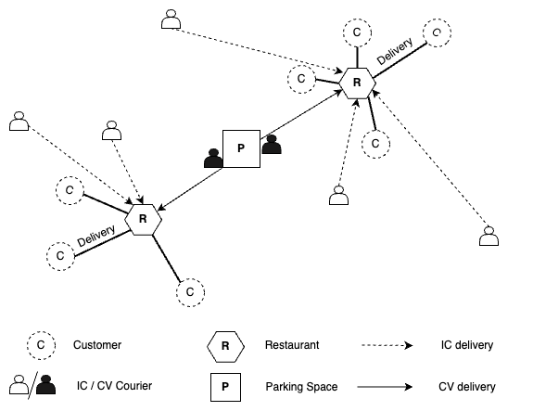
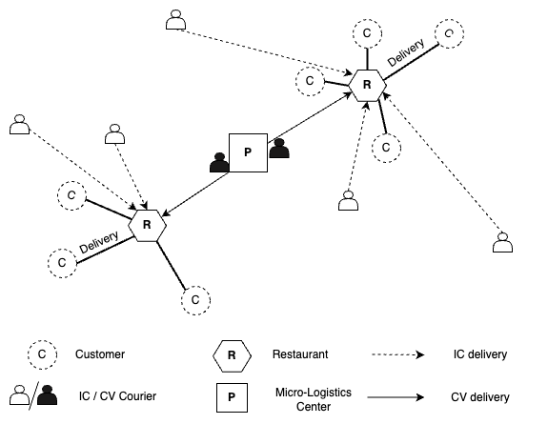
Research Question
To have centers or not ?
(delivery model choice)
If yes
Start Shift
End Shift
How to plan it?
3
Notes:
As you can see one of the key differences between the two models, is the facility, micro-logistics center. And the focus of our work is to determine whether to have centers or not, which also indicates the choice of delivery models, IC, CV or a hybrid one. And there’s also a follow-up question about this decision is, if it’s better to have centers, and how to plan these centers.

Slide 8
Methodology - Framework
Cost
To have centers or not ?
Center Dimensions
If yes
Number of Centers
Operational Considerations
(-> operational costs of centers)
How to plan it?
Locations
Courier Activities
Vehicle Fleet Size
4
Notes:
I’d like to show you the outline of framework to formulate this problem and I’ll explain them in detail later. We determine the necessity and the optimal plan of centers based on the objective of minimizing costs. For the planning of centers, we propose to consider these aspects: the number of centers, their locations and the number of vehicles stored in each center. We also include operational considerations into this strategic planning since they influence the costs of running these centers after construction. We can’t overlook this cost item when planning.

Slide 9
Research Question
How can we assess the economic viability and optimal planning of micro-logistics centers within a mixed structure of delivery models?
What criteria are crucial for evaluating the economic viability of centers in on-demand meal delivery?
Under what conditions is the company-vehicle delivery model economically advantageous, and how can we determine the optimal locations, coverage of these centers, as well as the inventory of company vehicles?
To have or not ?
If yes
How to plan it?
the number of centers
locations
Vehicle Fleet Size
1

Slide 10
Problem Description
Paid by Platform
Shift Start
Start First Delivery
End Last Delivery
Shift End
Non-productive Legs
Non-productive Legs
CV
5
Notes:
Let’s look into the impacts of having centers and the interaction between the couriers' activities with them. For the operation of CV couriers, as I mentioned earlier, they need to begin or end at these centers. Compared to IC couriers who start or end delivery directly, these CV couriers include some non-productive trips. Such travel times spent on these legs are afforded by the platform.

Slide 11
Problem Description
10:00 AM
11:00 AM
1 vehicle
Courier 1
13:00 PM
15:00 PM
Courier 2
17:00 PM
19:00 PM
Courier 3
13:00 PM
2 vehicles
10:00 AM
Courier 4
12:00 PM
14:00 PM
Courier 5
6
Notes:
Also, some couriers start at different times and have different shift lengths. These influence the number of vehicles needed in the optimal plan.
Like for the upper case, one vehicle can be used for 3 couriers with different shifts while 2 vehicles needed in the second case.
This is only a simple example (when optimization it thinks globally)

Slide 12
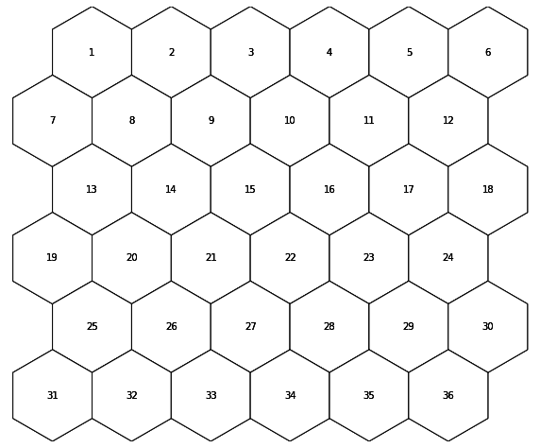
Problem Description - Network
Service Area
Hexagonal Network -> uniform adjacency

Slide 13
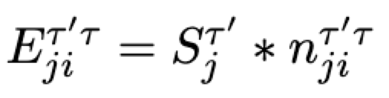
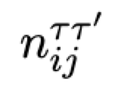
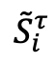
Problem Description – Couriers’ Distribution
(1 courier) Start Delivery
(1 courier) End Delivery
Time 3
Time 4
Time 5
Time 6
$${\tilde{S}}_{i}^{τ}$$
coverage
zone
7
Notes:
These spatial and temporal characteristics are reflected in the courier activity data we considered. And based on this, our model evaluates the impact of the centers and seeks for the optimal plan. The data include the locations where couriers start their delivery, the starting time and the number of such couriers, as well as the probability they may end at somewhere at a certain time. We divide the study area into hexagonal network and we call each hexagon, a zone and these data are counted on a zone level. And if a center provides company vehicles to the couriers starting delivery within this zone, we call the zone within the coverage of the center. As for the specific number of couriers planned to be included in CV service at this zone, we assume the platform considers a service level.
Service level (the company hired has more stability)
the percentage of time that a given number of couriers can adequately cover the observed courier activity patterns in a specific zone based on historical data.

Slide 14
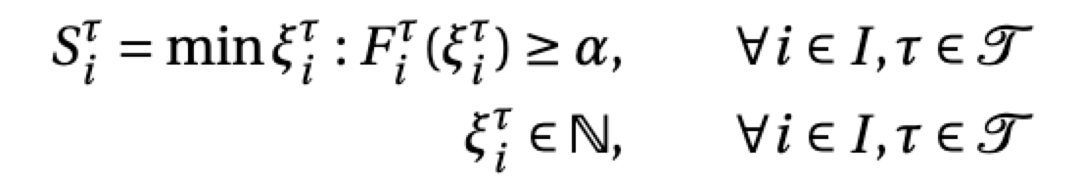
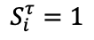
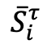
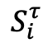
Problem Description – Couriers’ Distribution
Time 3
Time 4
Time 5
Time 6
$$S_{i}^{τ}$$
CV service
$${\tilde{S}}_{i}^{τ}$$
service level
$${\overline{S}}_{i}^{τ}$$
IC serve for the remaining
2
service level = 0.8
P(1>=#Couriers) =0.8
1
$$S_{i}^{τ}=1$$
0
1 2 3 4 5 6 7 8 9
7
Notes:
These spatial and temporal characteristics are reflected in the courier activity data we considered. And based on this, our model evaluates the impact of the centers and seeks for the optimal plan. The data include the locations where couriers start their delivery, the starting time and the number of such couriers, as well as the probability they may end at somewhere at a certain time. We divide the study area into hexagonal network and we call each hexagon, a zone and these data are counted on a zone level. And if a center provides company vehicles to the couriers starting delivery within this zone, we call the zone within the coverage of the center. As for the specific number of couriers planned to be included in CV service at this zone, we assume the platform considers a service level.
Service level (the company hired has more stability)
the percentage of time that a given number of couriers can adequately cover the observed courier activity patterns in a specific zone based on historical data.

Slide 15
Problem Description
…
CV
Commute
Commute
Shift Start
Shift End
8
Notes:
As for another impact of the center, the CV couriers need to commute between the centers and their homes. As you can imagine, if the commuting costs are quite high, they are less likely to be assigned CV couriers unless the company give some satisfying compensation.

Slide 16
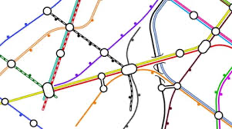
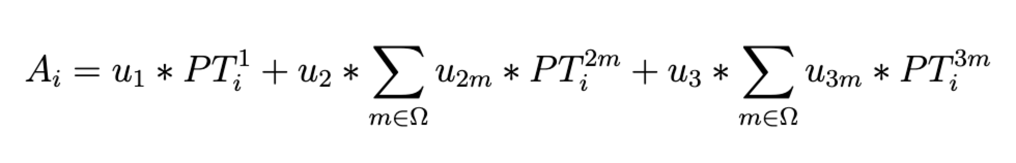
Problem Description
Number of stations (diff. modes)
Number of lines (diff. modes)
Number of connected zones
Zone Accessibility Score -- regarding the public transport connectivity condition within the zone
9
Notes:
Thus, the accessibility of the centers is also a key factor for the success of CV model. We assume the couriers use public transport to commute. Since it is hard to quantify the commuting costs due to the randomness and privacy of the living locations of couriers. Here we propose an alternative, the accessibility score to describe the public transportation condition within a zone. The higher the score a zone has, the more convenient it is for couriers to access.

Slide 17
Methodology - Framework
Cost Minimization
To have or not ?
Operational Consideration
If yes
Number of Centers
Courier Activities
How to plan it?
Locations
Quantity + Spatial-Temporal distribution
Vehicle Fleet Size
Vehicle Pick-up/Return (turnover)
Accessibility (Courier Convenience)
Comprehensive Planning Framework
10
Notes:
I’d like to give a quick summary here of the framework of our methods. With the goal of cost minimization, we first consider the necessity of centers the number, locations and vehicles they decide to hold. These decisions are interconnected. Meanwhile, the operational cost is also a critical component of total costs and the courier activities account for the costs to reposition couriers between centers and delivery locations. It also has an impact on the optimal fleet size decision. Particularly, when assessing the CV model, we also take the accessibility of zones into account and when determining the locations of the centers, we only select the candidate zones reaching a certain accessibility threshold. The complexity of this problem comes from the multiple considerations and their interconnected relationship.

Slide 18
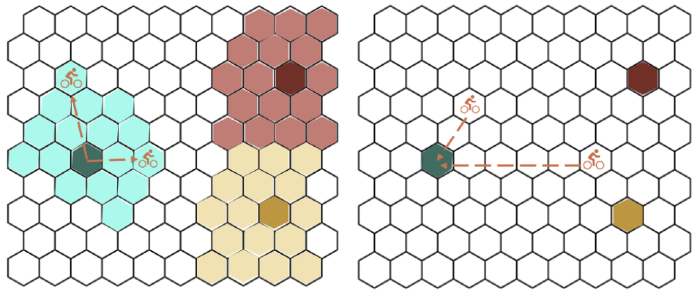
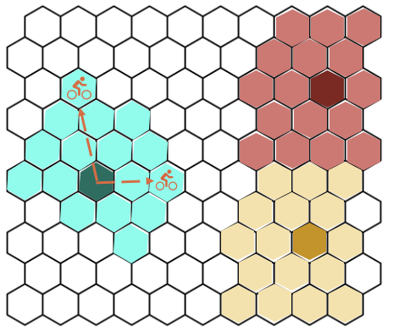
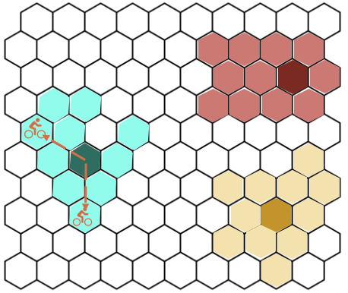
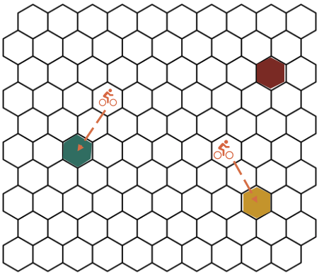
Mathematical Model
Objective
Model I
Cost Minimization (one operation day)
Parking Facility Construction
Investment Costs
Vehicle Depreciation
CV model
(a) Model I - Coverage & Vehicle Supply
(b) Model I- Returns
Model II
Non-Productive Legs
Operational Costs
Allowance
IC model
(a) Model II - Coverage & Vehicle Supply at time 1
(b) Model II - Coverage & Vehicle Supply at time 2
(c) Model II- Returns at a certain time
11
Notes:
To be specific, we aim to minimizing the total costs, which consist of the investment costs and operational costs for CV model, and the operational costs for the IC one. We also propose two models Model I and II to reflect different operational policy. In model I, we assume the coverage is fixed with continuity within the area, no hole no isolated one and something like that. Also, the vehicles originating from one center should be returned to the same center. For Model II, it can have a changing coverage varying with time. It also allows flexible parking.
I’ll skip the technical details of our model. And show you some insights from the results of this work.

Slide 19
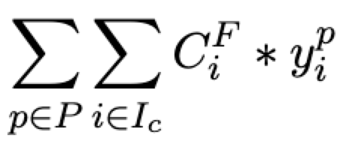
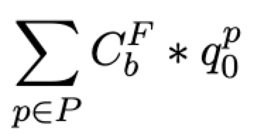
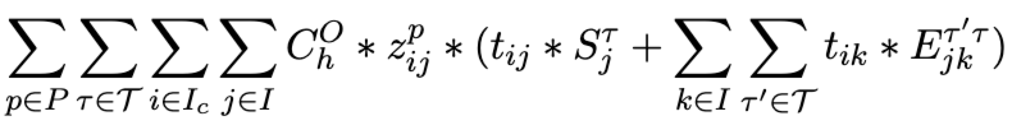
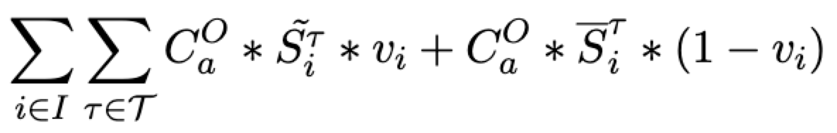
Mathematical Model – Model I
Objective
Parking Facility Construction
Vehicle Depreciation
min
Non-Productive Legs
Allowance
12

Slide 20
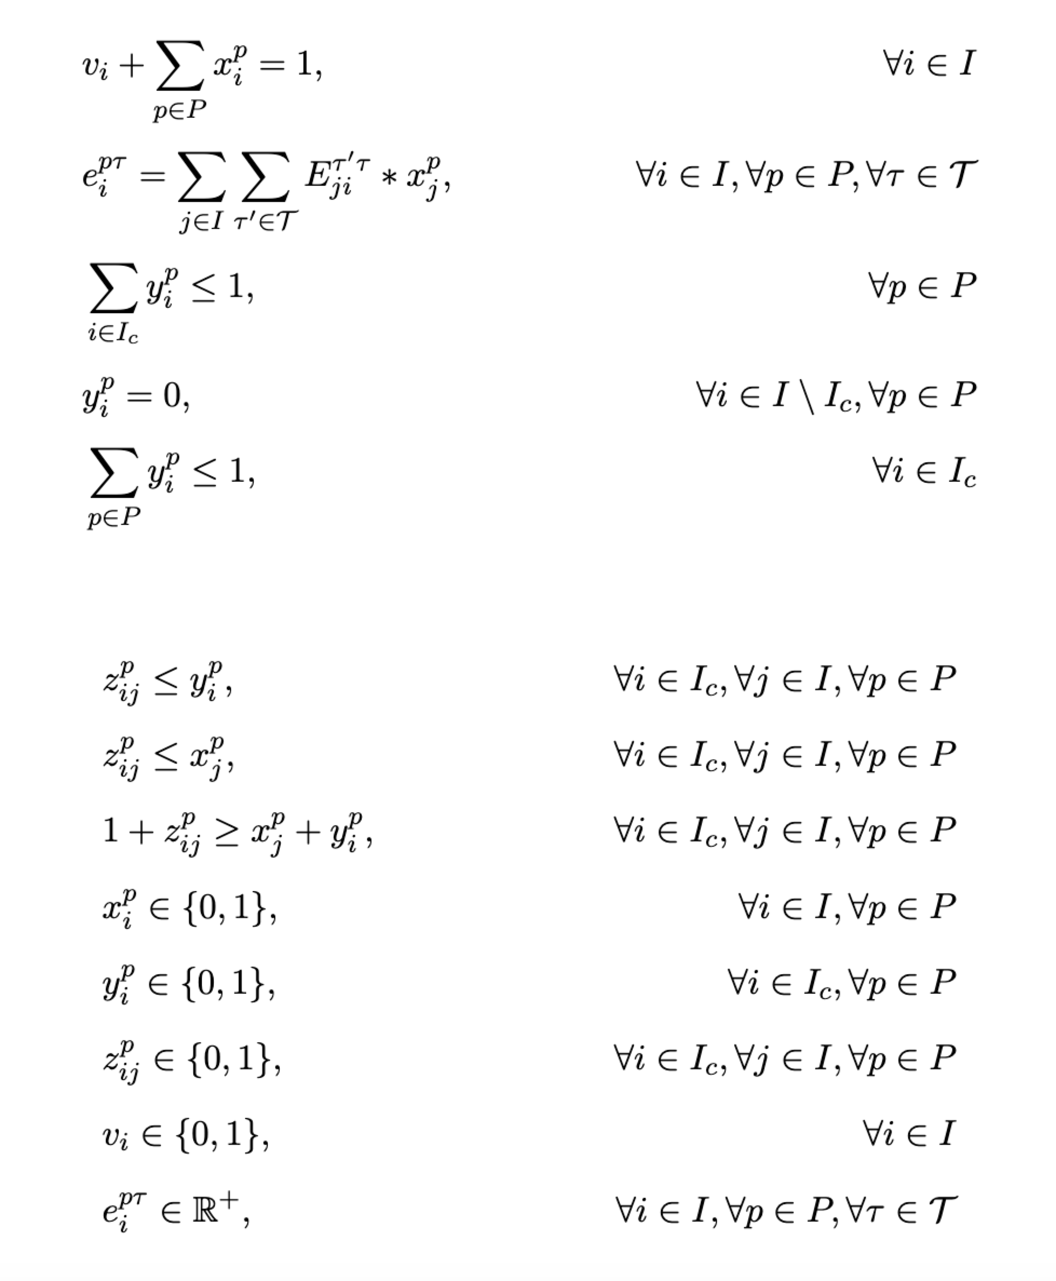
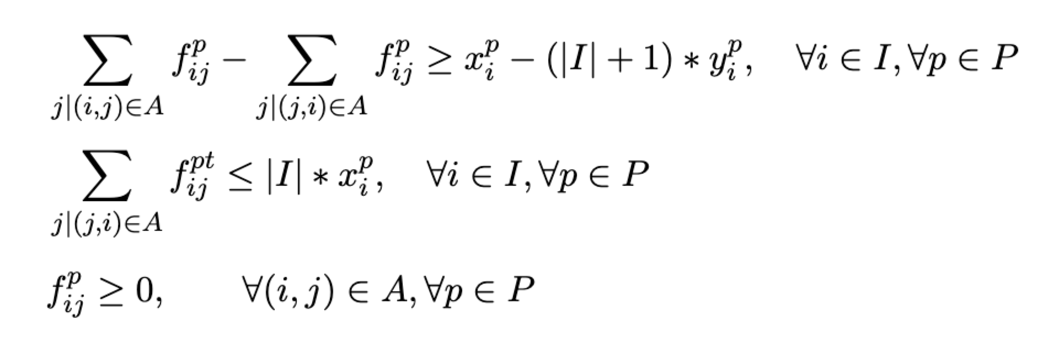
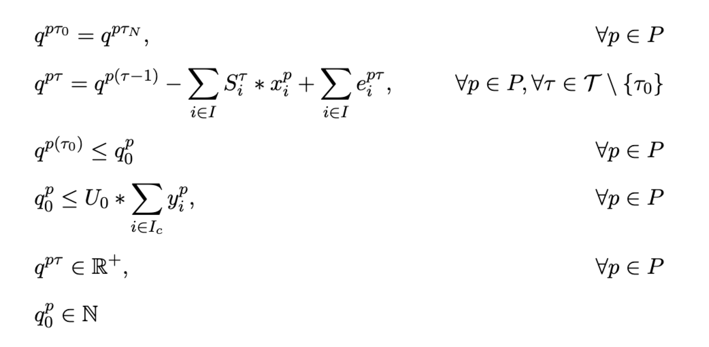
Mathematical Model – Model I
Constraints
Continuity
CV Couriers’ Activities & Vehicle Turnover
Allocation
13

Slide 21
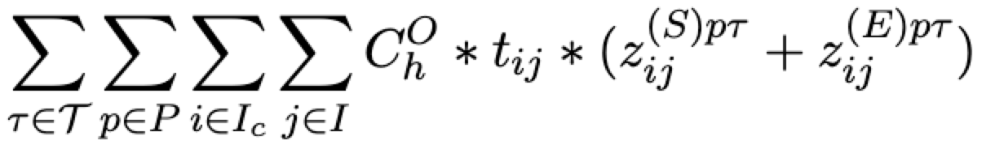
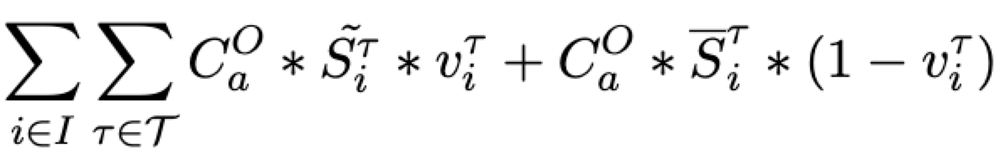
Mathematical Model – Model II
Objective
Parking Facility Construction
Vehicle Depreciation
min
Non-Productive Legs
Allowance
14

Slide 22
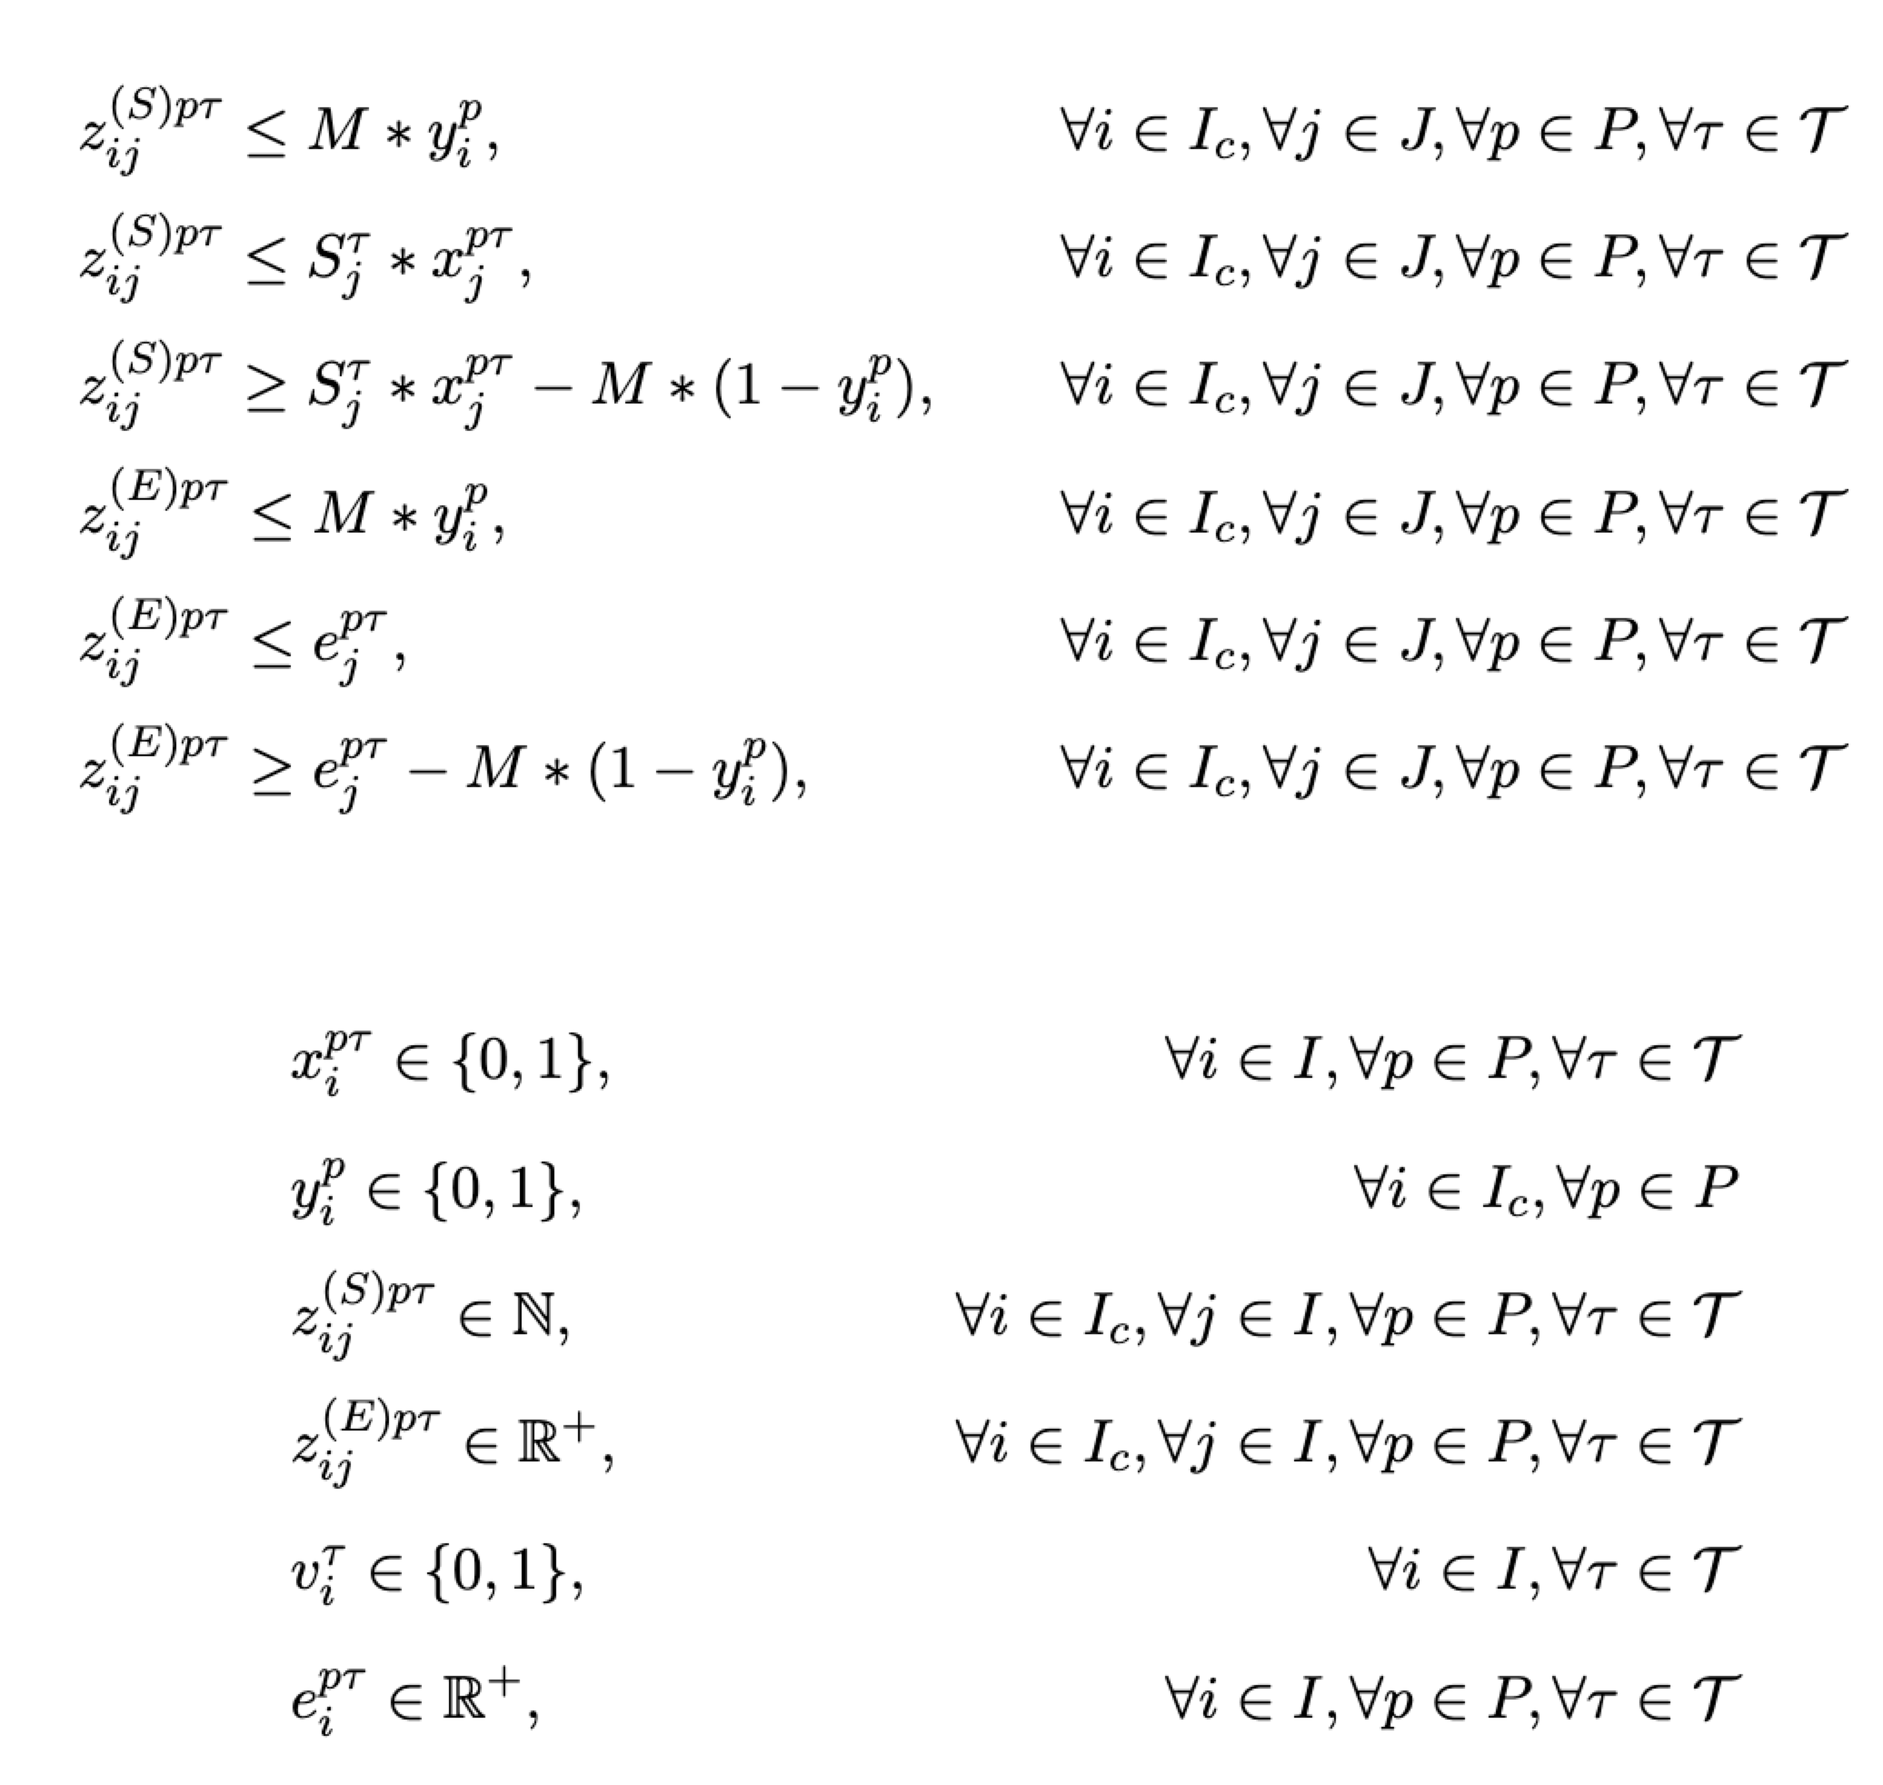
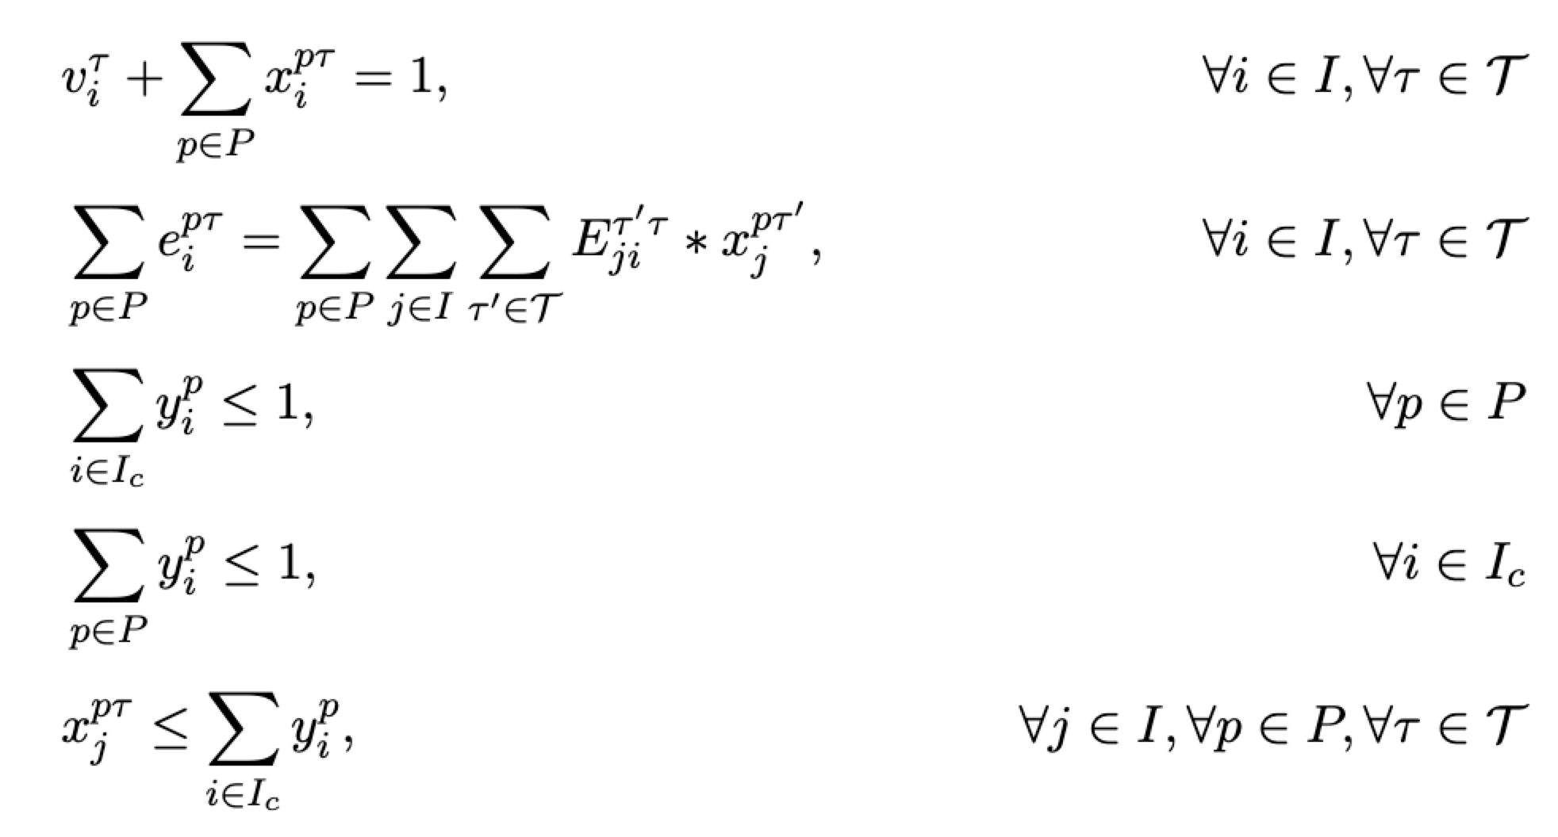
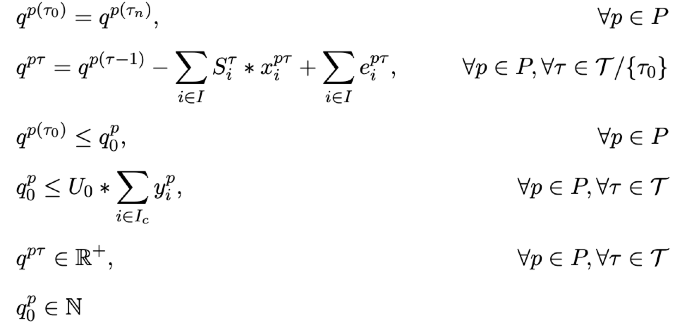
Mathematical Model – Model II
Constraints
Allocation
CV Couriers’ Activities
& Vehicle Turnover
15

Slide 23
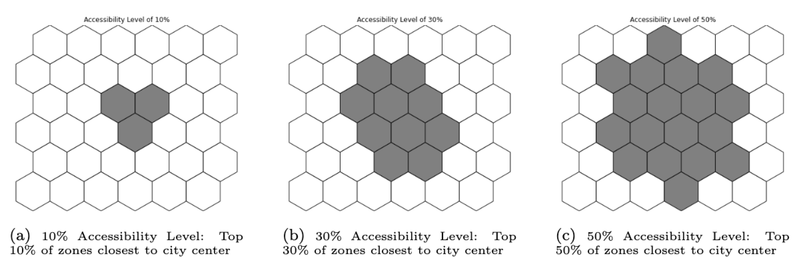
Instances
Input
Network – h3 (res 8, 0.737 km²)
6x6 network (36 zones): Representing smaller urban areas (e.g., Delft, Netherlands) or compact business districts;
9x9 network (81 zones): Representing medium-sized cities or expanded central business areas;
12x12 network (144 zones): Representing large cities (e.g., Den Haag, Netherlands) or extensive business areas of major metropolitan cities.
Accessibility Level
1
Notes:
These percentages represent the proportion of zones within the network whose ac- cessibility scores exceed a defined threshold, making them eligible as candidate parking locations. This can reflect cities with different rates of transportation infrastructure connectivity. In the following instances, we assume accessibility de- creases with distance from the city center, reflecting typical urban patterns where central areas have more diverse and frequent public transportation options, and the proportion, e.g, 10%, means the top 10% zones closest to the city center

Slide 24
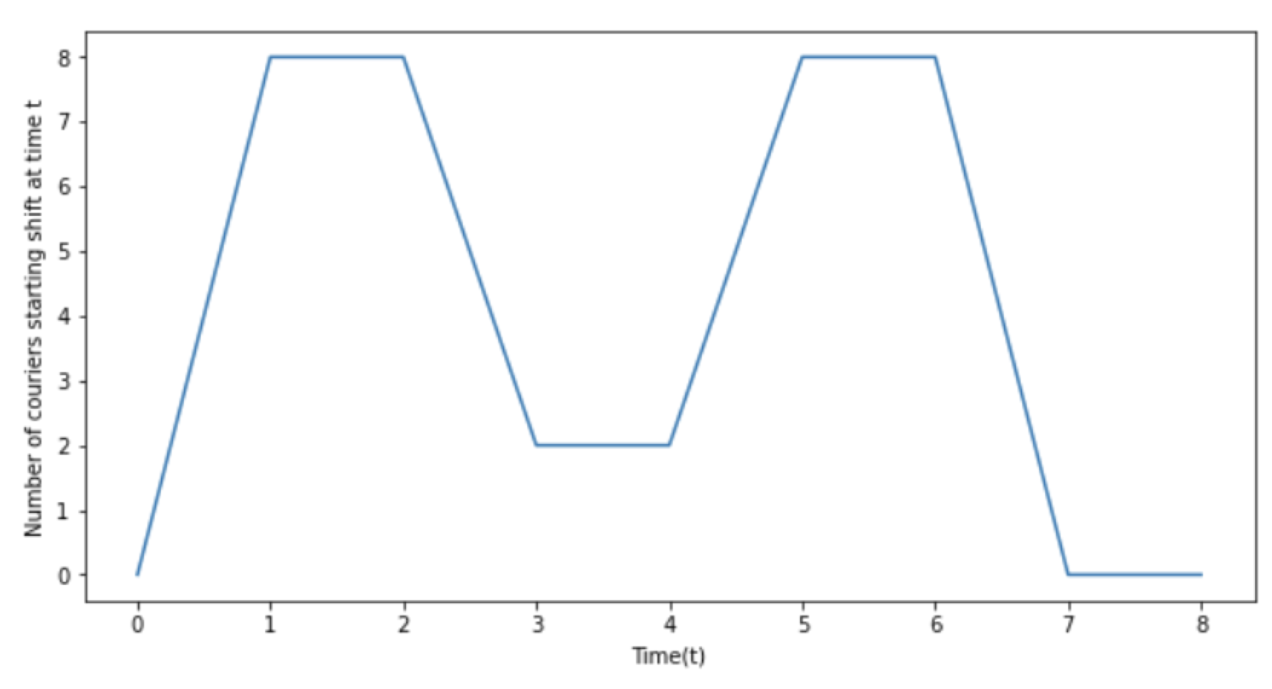
Instances
Input - Parameters
Operation Time: 08:30 AM - 22:00 PM (1.5-h intervals) T = {0, 1, 2, 3, ..., 7, 8, 9}
Lunch peak period [1, 2]: Hours from 11:00 AM to 14:00 PM;
Normal period [3, 4]: Hours from 14:00 PM to 17:00 PM;
Dinner peak period [5, 6]: Hours from 17:00 PM to 20:00 PM.
• Peak hours (lunch and dinner): 0.3 couriers/km2; • Normal period: 0.075 couriers/km2.
Couriers’ shift lengths: Normal Distribution
Mean of 2 time units (3 hours);
Standard deviation of 1 unit (1.5 hours);
Maximum of 3 units (4.5 hours);
Minimum of 1 unit (1.5 hours).
1

Slide 25
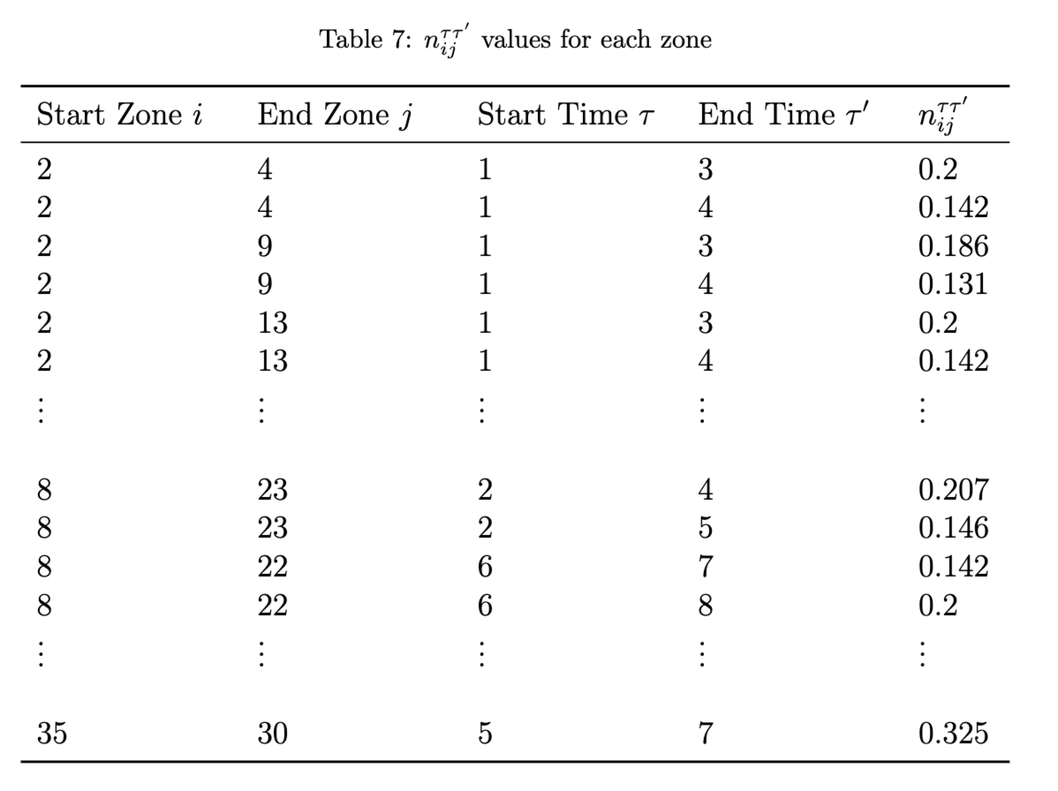
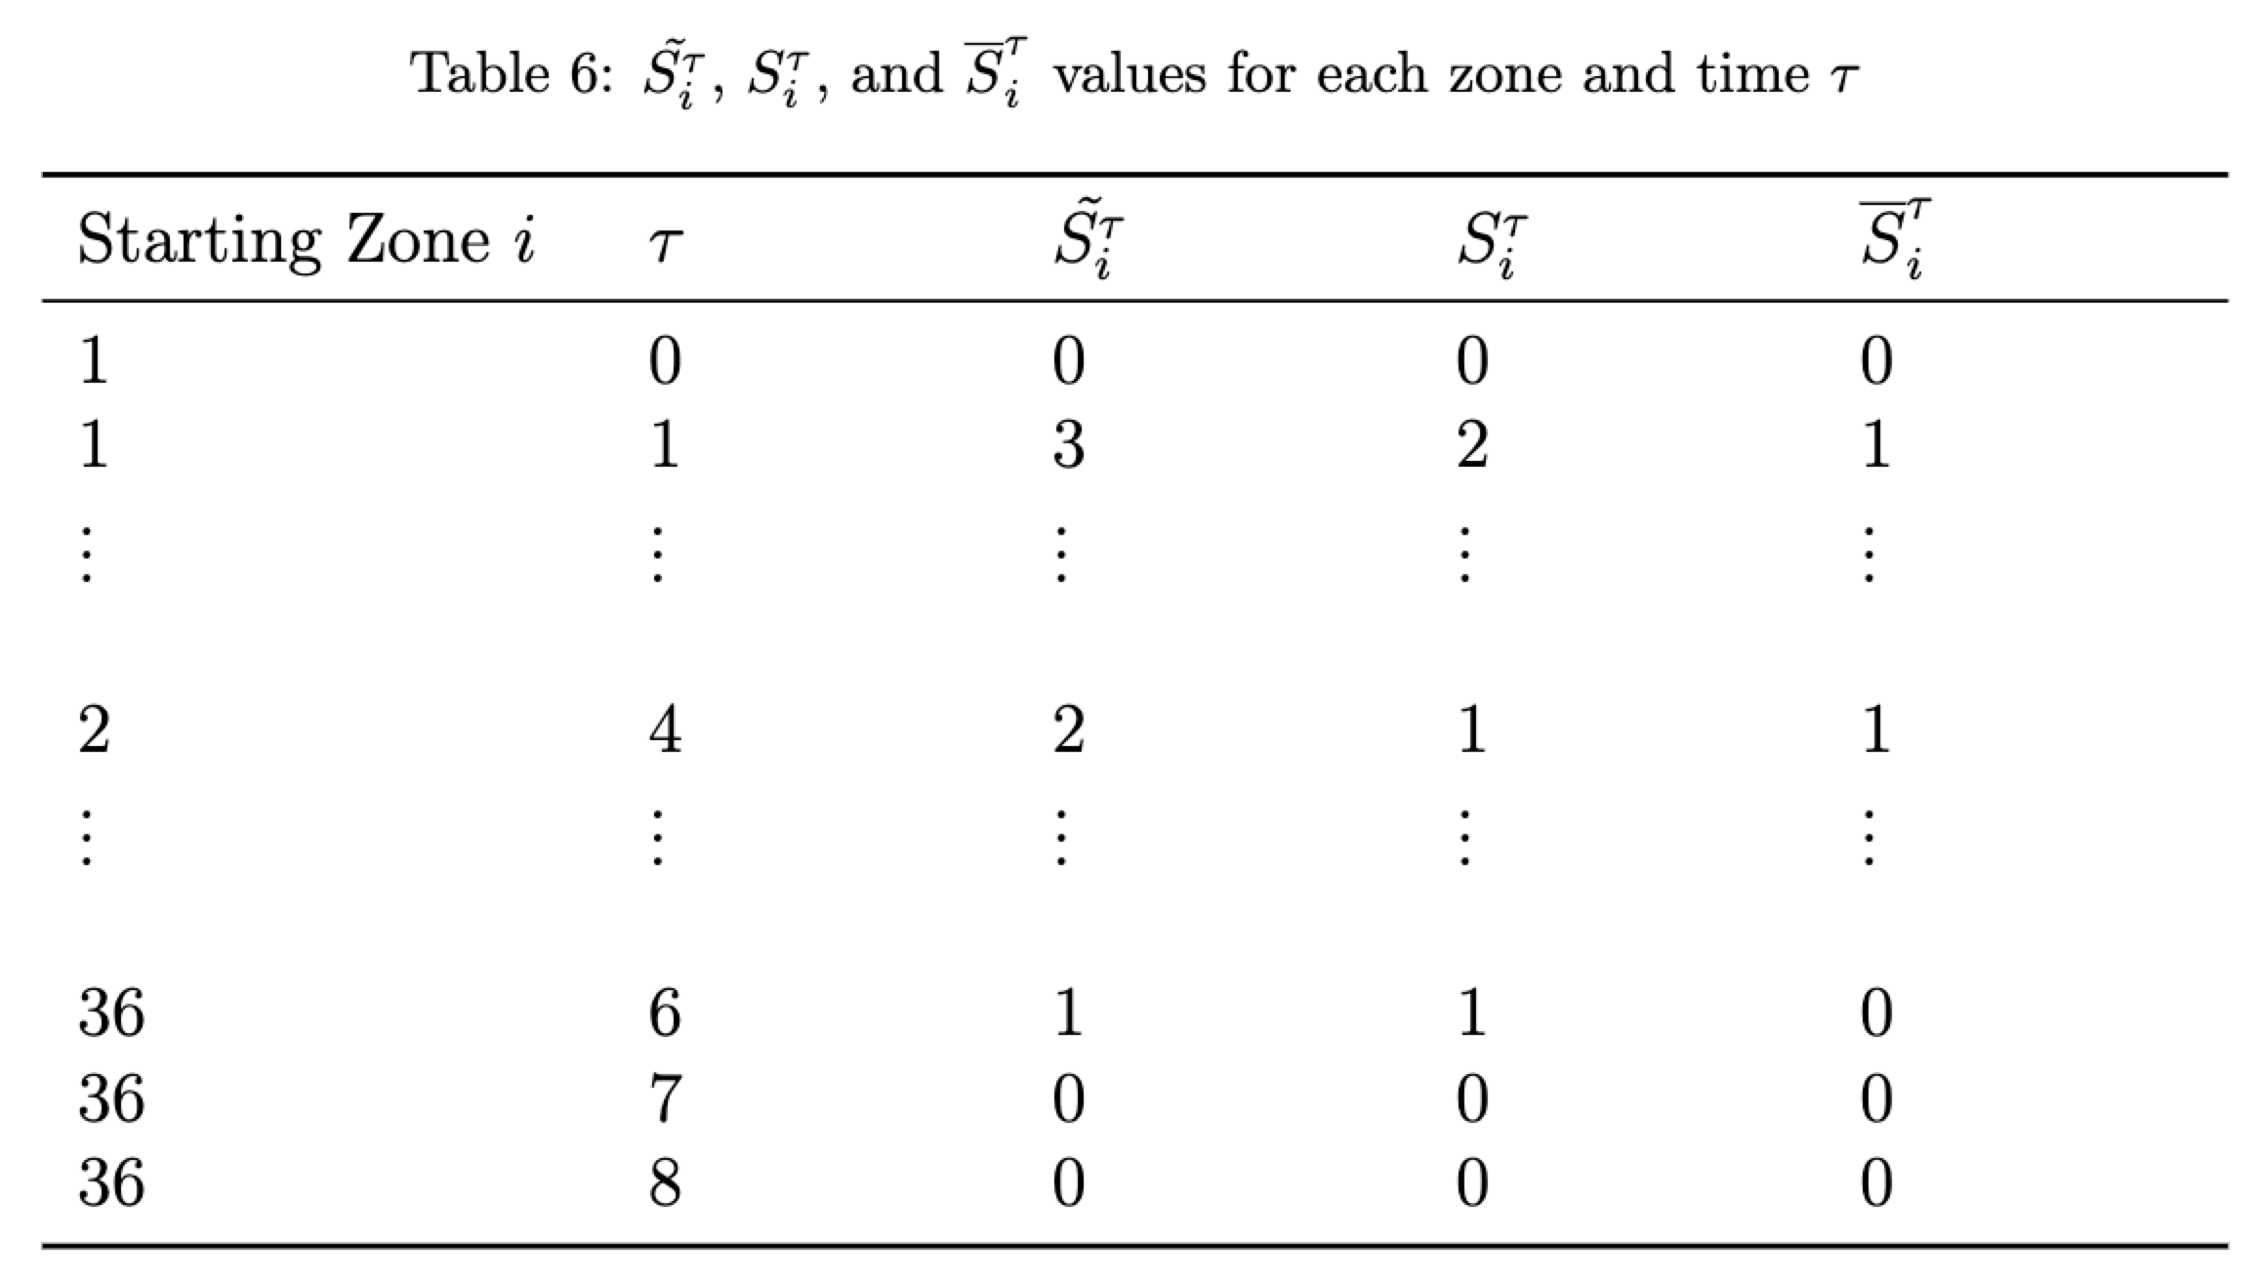
Instances
Input - Parameters
1

Slide 26
Results
Instances -> choices of delivery models under different conditions
Case Study - Amsterdam-> visualization + discussion on accessibility
16
Notes:
As you can imagine, the platforms need to adjust their strategy when facing different environments, we also want to investigate the different delivery model choices and the necessity of centers under different conditions. I’ll show this in various instances.
Then for the necessary centers, I’ll use the case study to show a visualization of the detailed results in a center plan and discussion on accessibility.

Slide 27
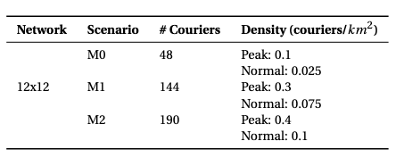

Instances – Market Maturity
M0: a new and sparse market
M1: a stable or well-established market
M2: cities with high demand for food delivery services
or busy metropolitan areas
M0
M1
M2
IC
Hybrid/CV
17
Notes:
many factors can influence the decision. Like the market maturity. Here we use different courier density to reflect different market maturity and found that IC model offers more flexibility and proves to be cost-effective in new markets and the hybrid one with a combination of IC and CV is better in a more established market.

Slide 28
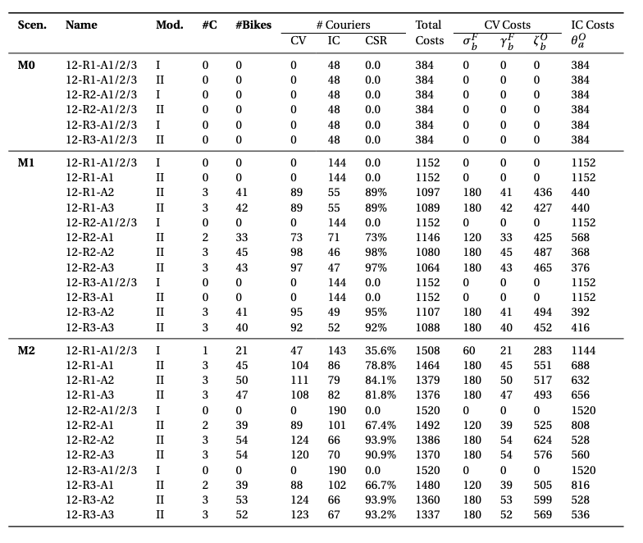
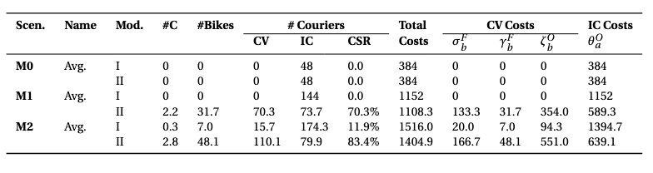
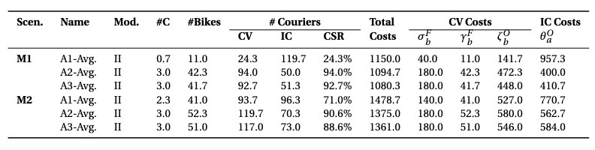

Slide 29
Instances-Urban Structure-Start Distribution
Restaurant Distribution
Concentrated
Spread-out
Hybrid/CV
IC
18
Notes:
And the urban structure also has a significant impact. as restaurants’ distribution is more spread out and the residential area is distant from the business area, the IC is more favorable.

Slide 30
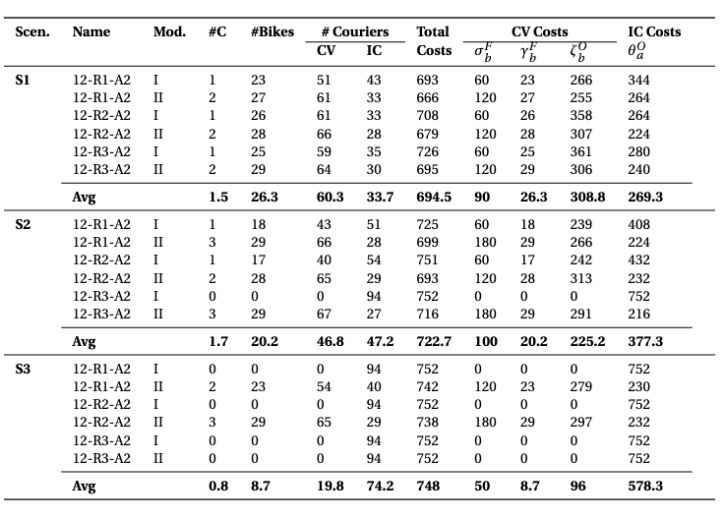

Slide 31
Instances-Urban Structure-End Distribution
Restaurant Distribution
Customer Distribution
Settings
Distance
Close
Distant
Hybrid/CV
IC
19

Slide 32
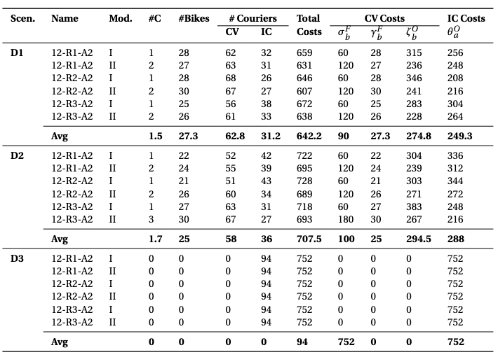

Slide 33


Instances-Cost Dynamics
Low
(e.g., lower real estate prices)
Facility Cost
High
(e.g., high-rent urban centers)
Hybrid/CV
(also more centers)
IC
Low
(e.g., market with surplus gig workers)
IC Allowance Rate
High
(e.g., market with gig workers of bargain power)
IC
Hybrid/CV
20
Notes:
Also, the costs matter. The optimal delivery strategy varies with different facility cost and allowance for IC couriers.

Slide 34
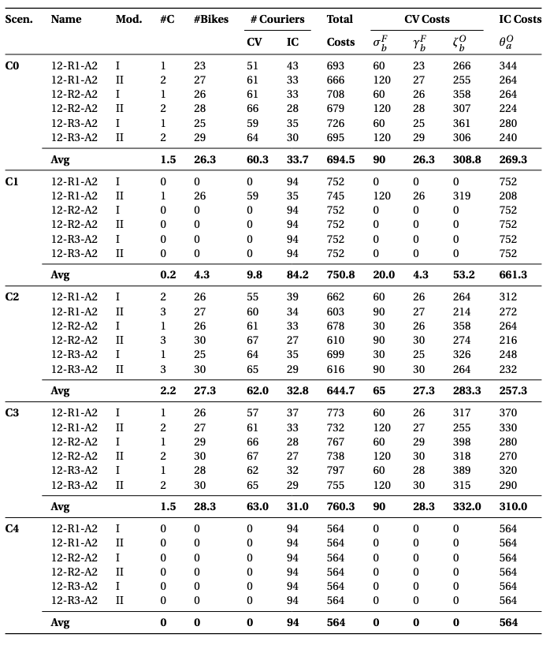
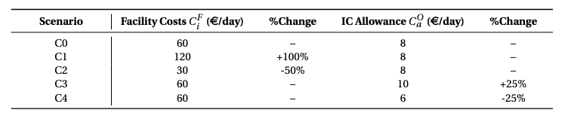

Slide 35



Instances-Couriers’ Transport Mode
Slower
Cheaper
Faster
More costly
IC
Hybrid/CV
IC
21
Notes:
Furthermore, do you remember the aspects we want to determine in the CV model? Our results also suggest the platform should consider the balance between speed and costs to decide on adopting which type of company vehicle.

Slide 36
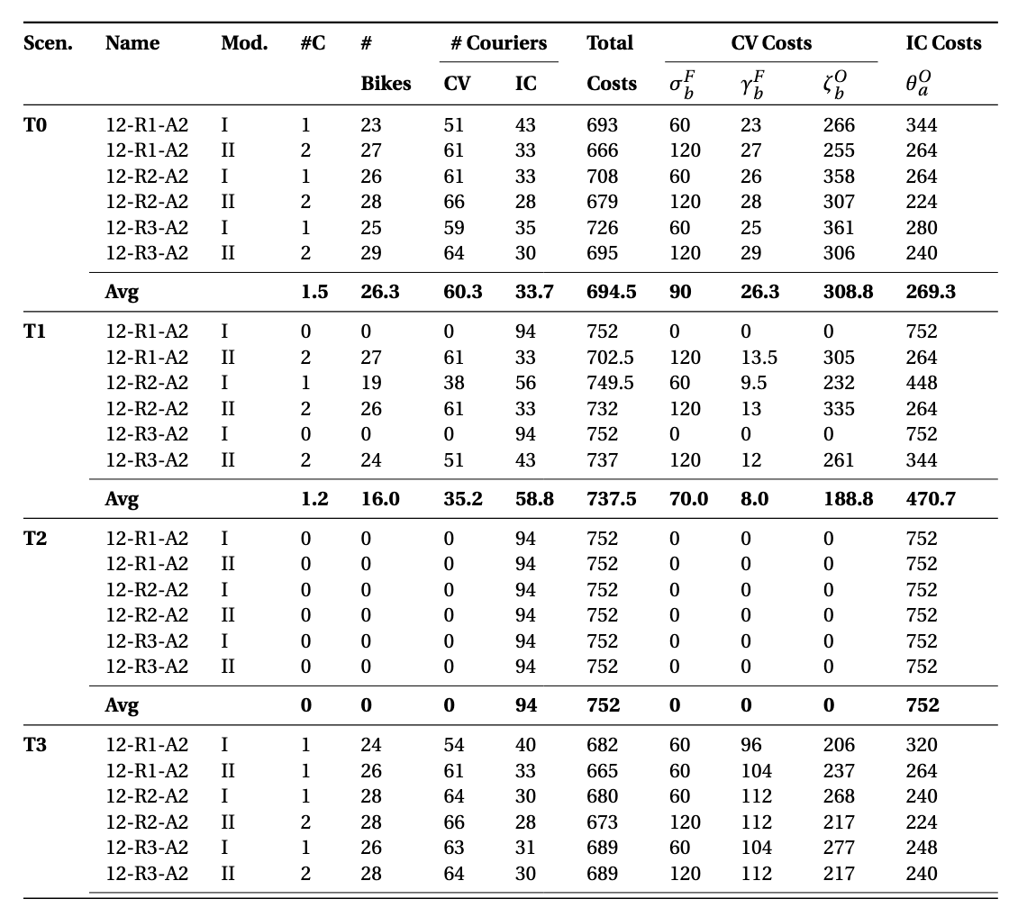
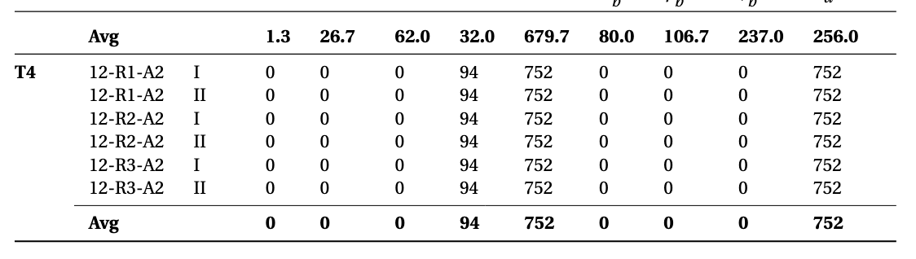
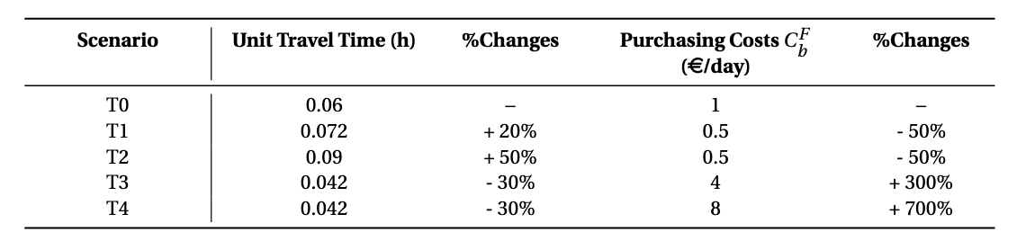

Slide 37
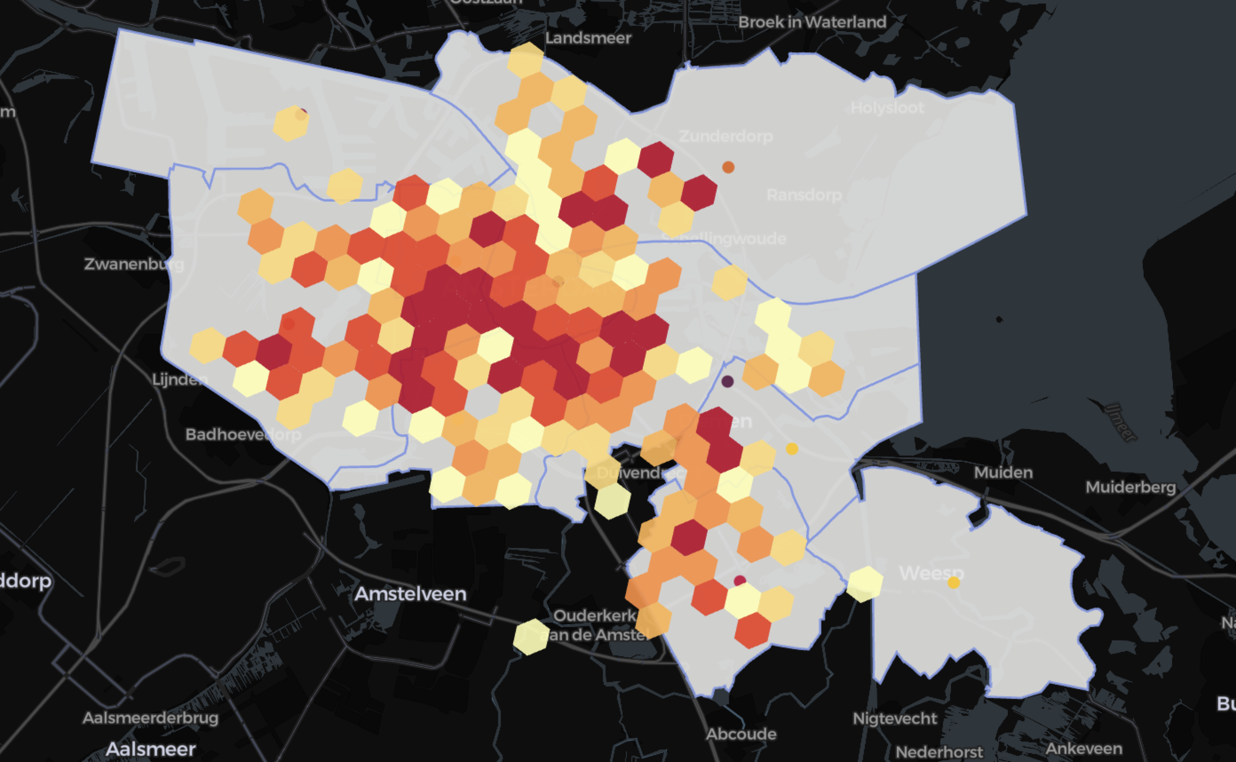
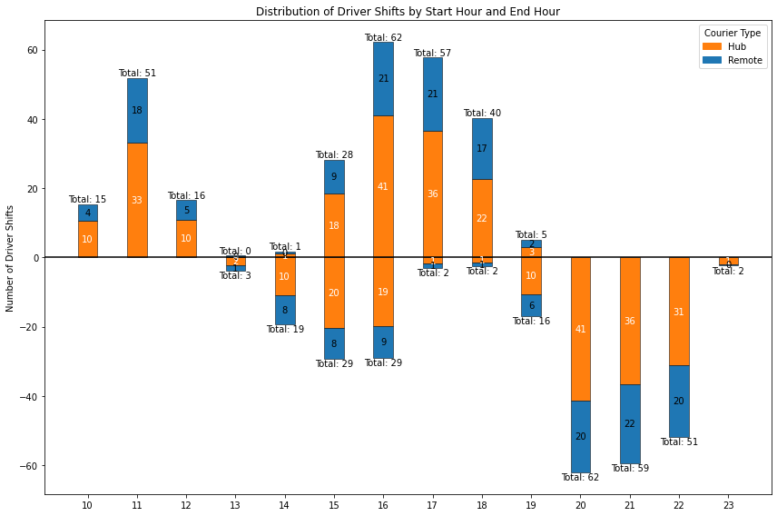

Case Study - Amsterdam City
Start Distribution -> Restaurants
Input
Shift
End Distribution -> Customer
22
Notes:
415
As for the Amsterdam case, we consider the spatial and temporal distribution of couriers with the data from one operator.

Slide 38


Slide 39



Case Study - Amsterdam City
Input
15 Tram Lines, 139 Tram Stations
5 Metro Lines, 11 Metro Stations
81 Bus Lines (bidirectional), 893 Bus Stations
4 Train Lines, 13 Train Stations
23
Notes:
For example 0.2 163 zones’ a score exceed the threshold
And we calculate the accessibility score based on the current public transportation network in Amsterdam. Here lists different number of candidate locations with different thresholds.

Slide 40




Case Study - Amsterdam City
Results
Time 2
.
.
.
Time 7
Illustration of Model I Results
(for all time)
Time 8
Illustration of Model II Results
24
Notes:
In this case, there are multiple centers needed and here’s a visualization of the detailed plan of them.
Hybrid delivery model and multiple parking facilities
the dynamic approach offers additional benefits 15% reduction in operational costs. It enables dynamic coverage and flexible parking choices, resulting in lower average access costs to parking facilities for couriers

Slide 41

Case Study - Amsterdam City
Results
invest a marginal amount to provide better courier convenience
25
Notes:
Also, we found that the costs of the optimal plan didn’t change much when changing the threshold. It is because due to the overlap of the areas with well-developed public transport connections and the business area for courier activity, and it limits the optimal locations into several choices. And from another perspective, it also means that, the platform can invest a little bit to provide greater convenience for more couriers by choosing locations with higher accessibility score.

Slide 42
Contributions
A comprehensive framework with operational considerations for the decision-making on delivery model choice and micro-logistics center planning
Insights on adapting strategy according to different environments
26
Notes:
The delivery model choice and facility topic in the area of on-demand food delivery service is less studied. This work provides a comprehensive and integrated framework to fill this gap. Also, we add the operational considerations and consider multiple interconnected factors.
We also provide some practical insights to help platforms determine the most cost-effective delivery plan and also offer some discussion on the impact of different urban transportation developments on the model choice as well as suggestions on the operational model choice when considering daily operation or scaling up. Some of them are not included in today’s presentation but can be found in my report.

Slide 43
Future Work
Facility cost variations based on the fleet size + buffer capacity
Rebalancing possibility
Deterministic inputs -> stochastic data
27

Slide 44
Thank you for your attention !
Yuchen Qi

Slide 45



